Slide 1
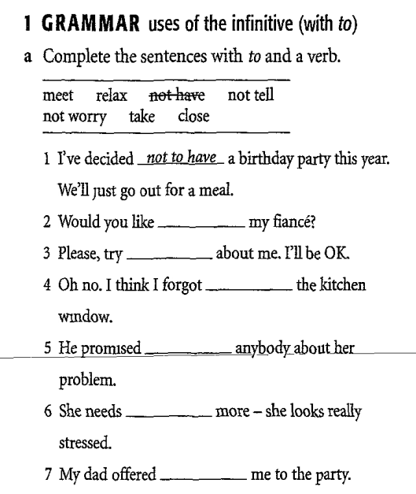
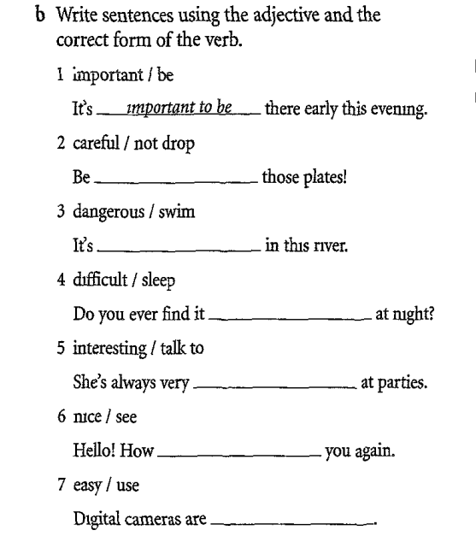

Slide 2
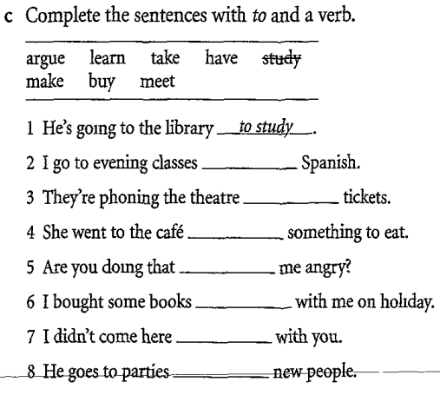
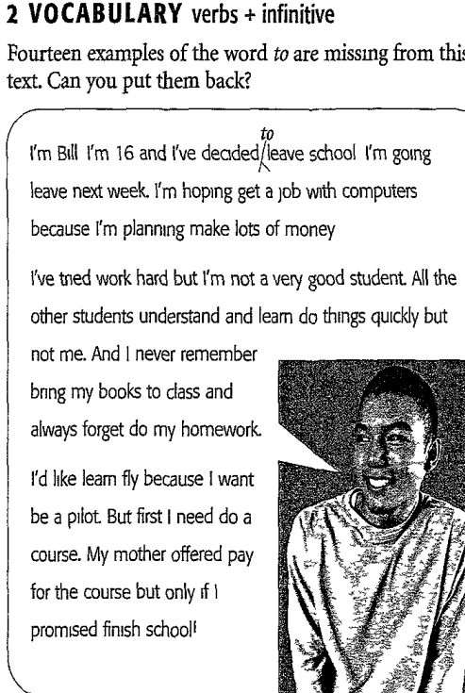

Slide 3
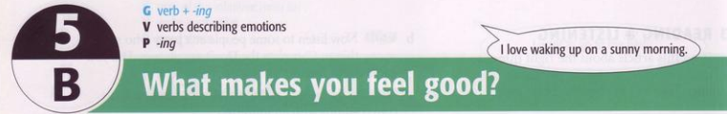
* Mục đích: Provide students:
+ Grammar: verb + -ing
+ Vocabulary: verbs follow by -ing
+ Pronunciation and speaking : -ing
* Yêu cầu: After lesson, students can:
+ Uses verb + -ing correctly to make sentences
+ Form and spell “ing” and the letters

Slide 4
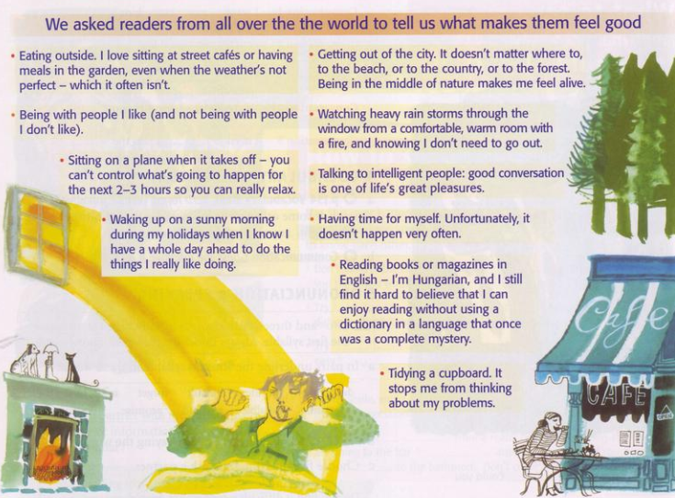
1. READING: Read the article
Answer the questions:
How many people mention…?
1. the weather
three (paragraphs 1, 4, 6)
2. holidays and travelling
three (paragraphs 3, 4, 5)
3. Housework
one (paragraph 10)
4. Nature
one (paragraph 5)
5. other people
two (paragraphs 2,7)

Slide 5
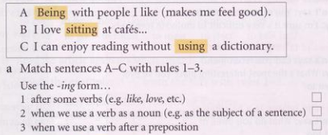
2. GRAMMAR: verb + -ing
B
A
C

Slide 6
b. Look at the highlighted verbs. Can you remmerber the spelling rules for making the -ing form?
Eating outside in the summer makes me feel good.
I love reading in bed.
I’m thinking of buying a new car
As the subject of a sentence.
Ex: Smoking is bad for you
After some verbs (like, love, hate, enjoy, etc.)
Ex: I hate getting up early
After prepositions (to, with, without, etc.)
Ex: He left without saying goodbye
Uses verb + -ing:

Slide 7
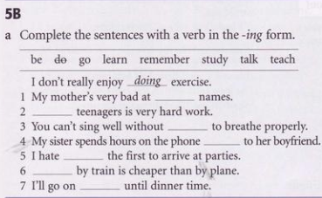
Exercises
remembering
Teaching
learning
talking
being
Going
studying

Slide 8
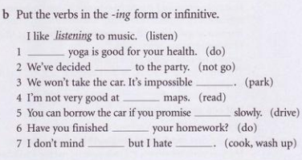
Doing
not to go
to park
reading
to drive
doing
cooking
washing up
https://quizizz.com/admin

Slide 9
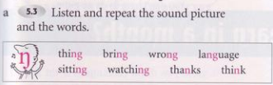

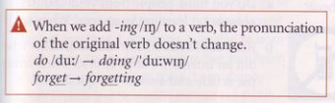
3. PRONUNCIATION -ing

Slide 10
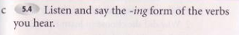
think
drive
study
do
go
thinking
driving
studying
doing
going
remember
forget
try
ski
write
fly
remembering
forgetting
trying
skiing
writing
flying

Slide 11
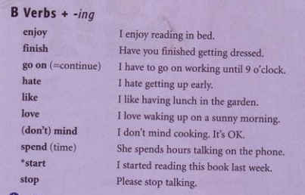
4. VOCABULARY & SPEAKING
a. Verbs which are followed by the -ing form (p.154)

Slide 12
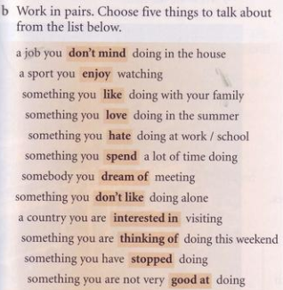
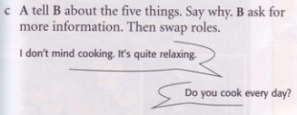

Slide 13
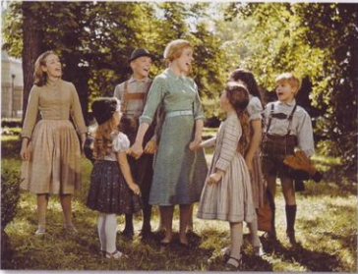
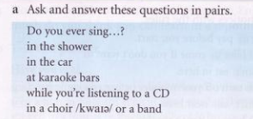
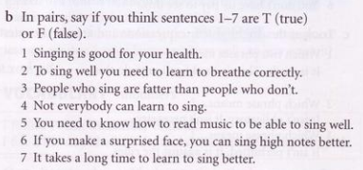
5. LISTENING
T
T
F
F
F
T
F

Slide 14
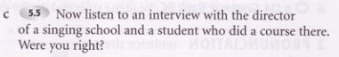
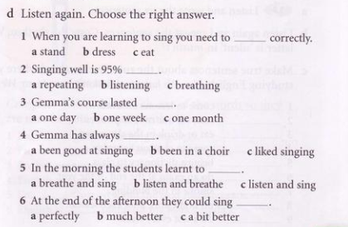
stand
listening
one day
liked singing
breathe and singing
much better

Slide 15
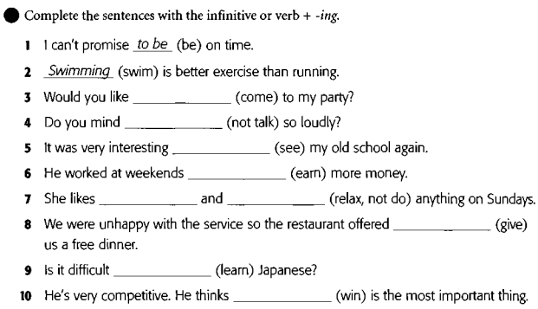
Exercises
to come
not talking
to see
to earn
relaxing
not doing
to give
to learn
winning

Slide 16
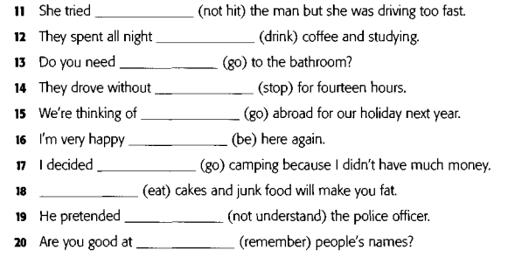
not to hit
drinking
to go
stopping
going
to be
to go
Eating
not to understand
remembering

Slide 17
